Slide 1
Developer WorkBench
PMD - Code Review Tool

Slide 2
Lesson Objectives
In this lesson, you will learn:
What is PMD
PMD Rulesets
PMD usage
PMD in Action

Slide 3
What is PMD?
Automated code review utility for java
Static code analyzer
Automatically detects a wide range of potential defects and unsafe or non-optimized code
Focuses on preemptive defect detection

Slide 4
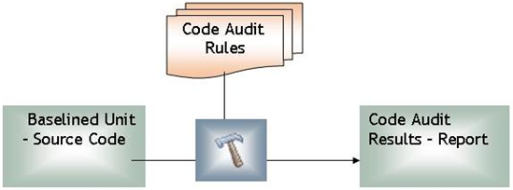
What is PMD? (Contd…)
Possible bugs: Empty try/catch/finally/switch statements
Dead code: Unused local variables, parameters and private methods
Suboptimal code: Wasteful String/String Buffer usage
Overcomplicated expressions - Unnecessary if statements, for loops that could be while loops
Duplicate code: Copied/pasted code means copied/pasted bugs

Slide 5
PMD Rule Sets
Rules are grouped together and form a Rule Set
E.g. Basic Rules, Code Size Rules, Coupling Rules,
Design Rules, JavaBeans Rules, Junit Rules, Migration
Rules, Naming Rules, Optimization Rules, Security Code
Guidelines, Unused Code Rules, etc.
For more information visit:
http://pmd.sourceforge.net/rules/index.html

Slide 6
PMD Usage
Installation:
Windows and UNIX
Prerequisites:
JDK 1.4 or higher
WinZip for Windows or "zip" utility InfoZip for UNIX
Download the latest binary distribution - i.e., pmd-bin-x.xx.zip from http://pmd.sourceforge.net/index.html. Unzip it into any directory
*Note: Please contact ITIMD Helpdesk to download the plug-in

Slide 7
Integration with IDE’s
PMD can be integrated with following IDE’s:
Eclipse
Jdeveloper
Jedit
Jbuilder
BlueJ
CodeGuide
NetBeans/Sun Java Studio Enterprise/Creator
IntelliJ IDEA
TextPad
Maven
Ant
Gel
Jcreator
Emacs

Slide 8
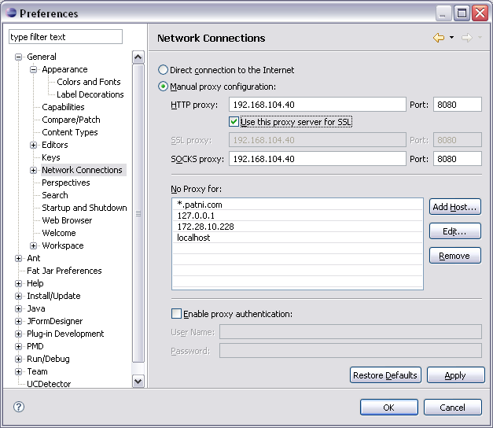
Integration with Eclipse IDE
Configure Eclipse:
Setup the network connection in Eclipse preferences. Go to Windows -> Preferences -> General -> Network Connection
Set your preferences as per your Internet Browser Connections Settings

Slide 9
Integration with Eclipse IDE (Contd…)
To install PMD plug-in,
Start Eclipse and open a project
Select "Help"->"Software Updates"->"Find and Install“
Click "Next", then click "New remote site“
Enter "PMD" into the Name field and "http://pmd.sf.net/eclipse" into the URL field ( this downloads the plug in from the site)
Click through the rest of the dialog boxes to install the plug-in
Alternatively, you can download the latest zip file and follow the above procedures except for using "New local site" and browsing to the downloaded zip file.

Slide 10
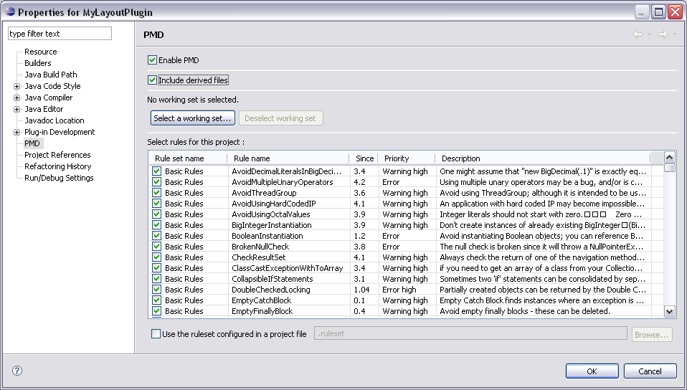
Integration with Eclipse IDE (Contd…)
Configuring PMD in a Project:

Slide 11
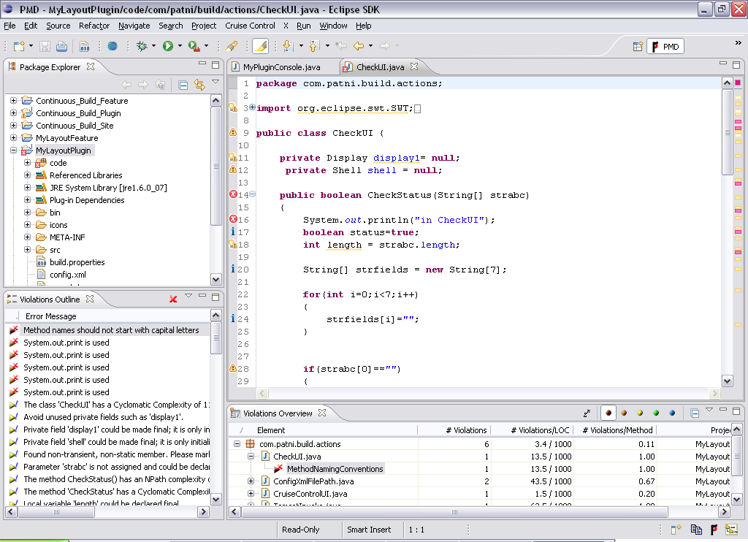
Integration with Eclipse IDE (Contd…)
To run PMD with Eclipse – Right click on the project, select PMD – Check Code with PMD

Slide 12
PMD In Action
PMD is quite flexible. You can use it in two basic ways:
Wait for PMD to automatically analyze a file each time it is saved or added to the project
Manually execute it against selected files, folders, or projects

Slide 13
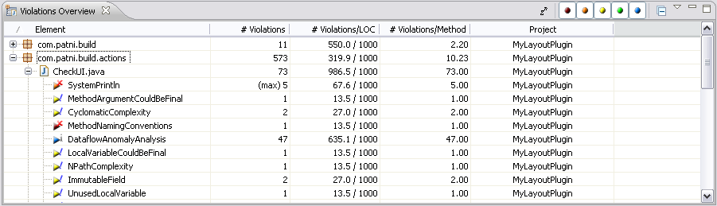
PMD In Action (Contd…)
PMD violations have the following five levels of severity:
Error (high)
Error
Warning (high)
Warning
Information

Slide 14
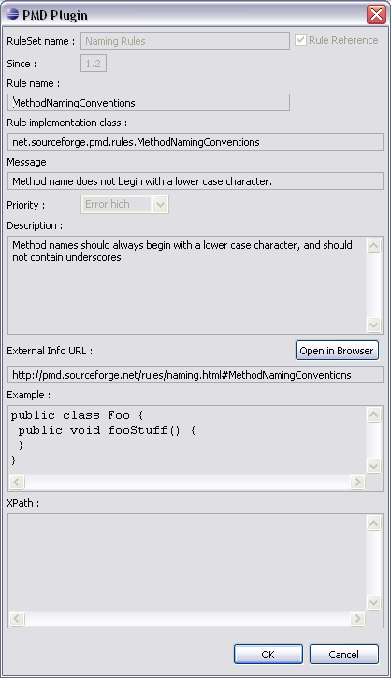
PMD In Action (Contd…)
Details of the Rule

Slide 15
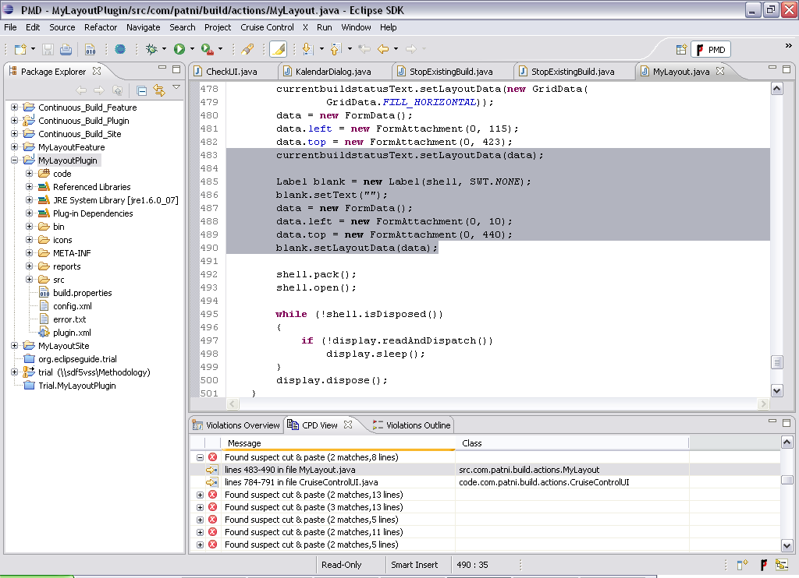
PMD In Action (Contd…)
Detecting Cut Pasted Code

Slide 16
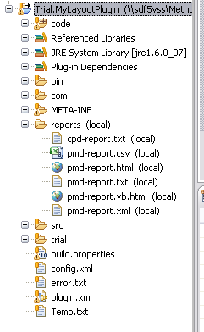
PMD In Action (Contd…)
Reporting Feature: PMD generates reports in following formats:
.txt
.csv
.html
.vb.html
.xml

Slide 17
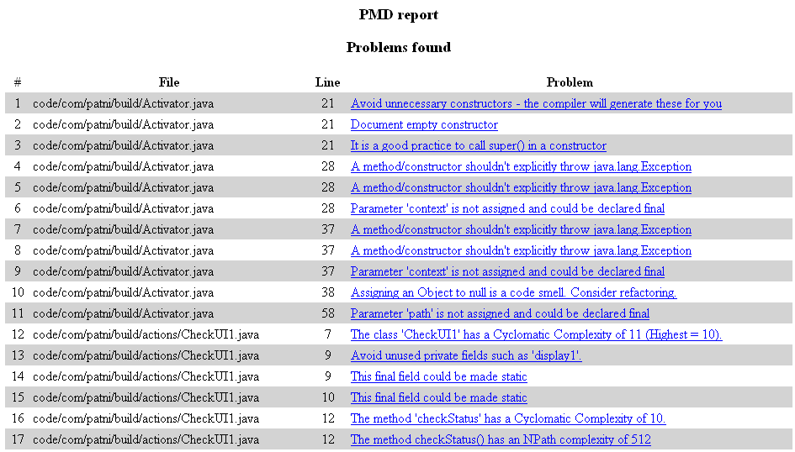
PMD In Action (Contd…)
HTML Reporting Format:

Slide 18
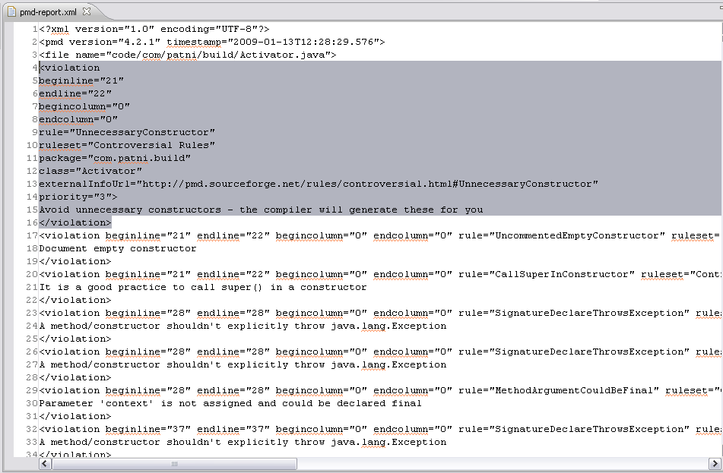
PMD In Action (Contd…)
XML Reporting Format:

Slide 19
Customizing PMD
It is possible to create your own rules and rule sets
For additional information and detailed description on customizing PMD visit,
http://www.jacoozi.com/index.php?option=com_content&task=view&id=121&Itemid=134
http://pmd.sourceforge.net/

Slide 20
Lab
1.Installing PMD
2.Using PMD with Eclipse

Slide 21
Summary
Learned the usage of PMD
Understood how to Integrate PMD with Eclipse IDE

Slide 22
Review Question
Question 1: PMD is a
Review tool
Testing Tool
Design Tool
Question 2: PMD violations has __________ level of severity
Error (high)
Fatal
Warning (high)
Information

